Slide 1

Network Design For
LMN Financial Group

Slide 2


Group members
IT23366336 – A.M.N.S WEERARATHNE
IT23363670 – E.D.O.SAMARAKOON
IT23363052 – K.H.S.DAMSILUNI
IT23362994 - H.M.C.M.B.HEARATH

Slide 3
LOGICAL TOPOLOGY

Slide 4

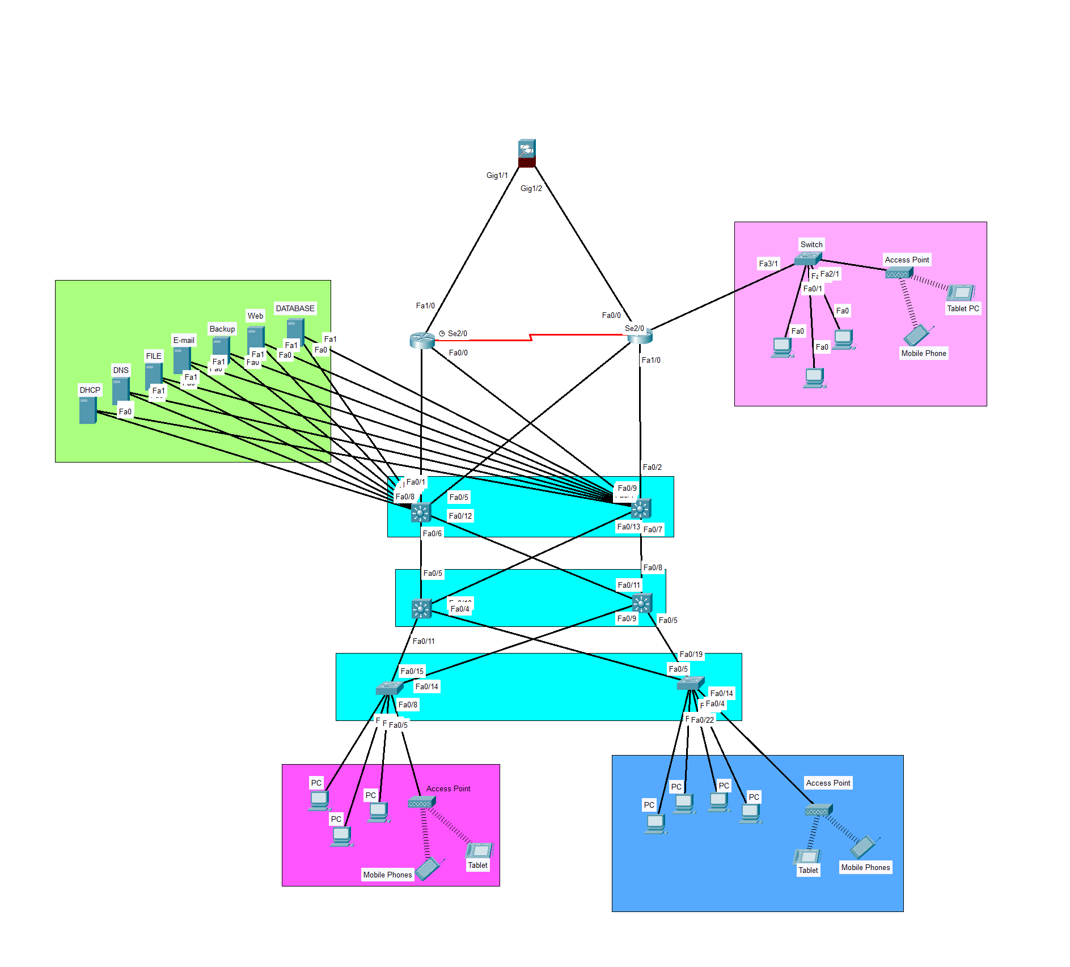
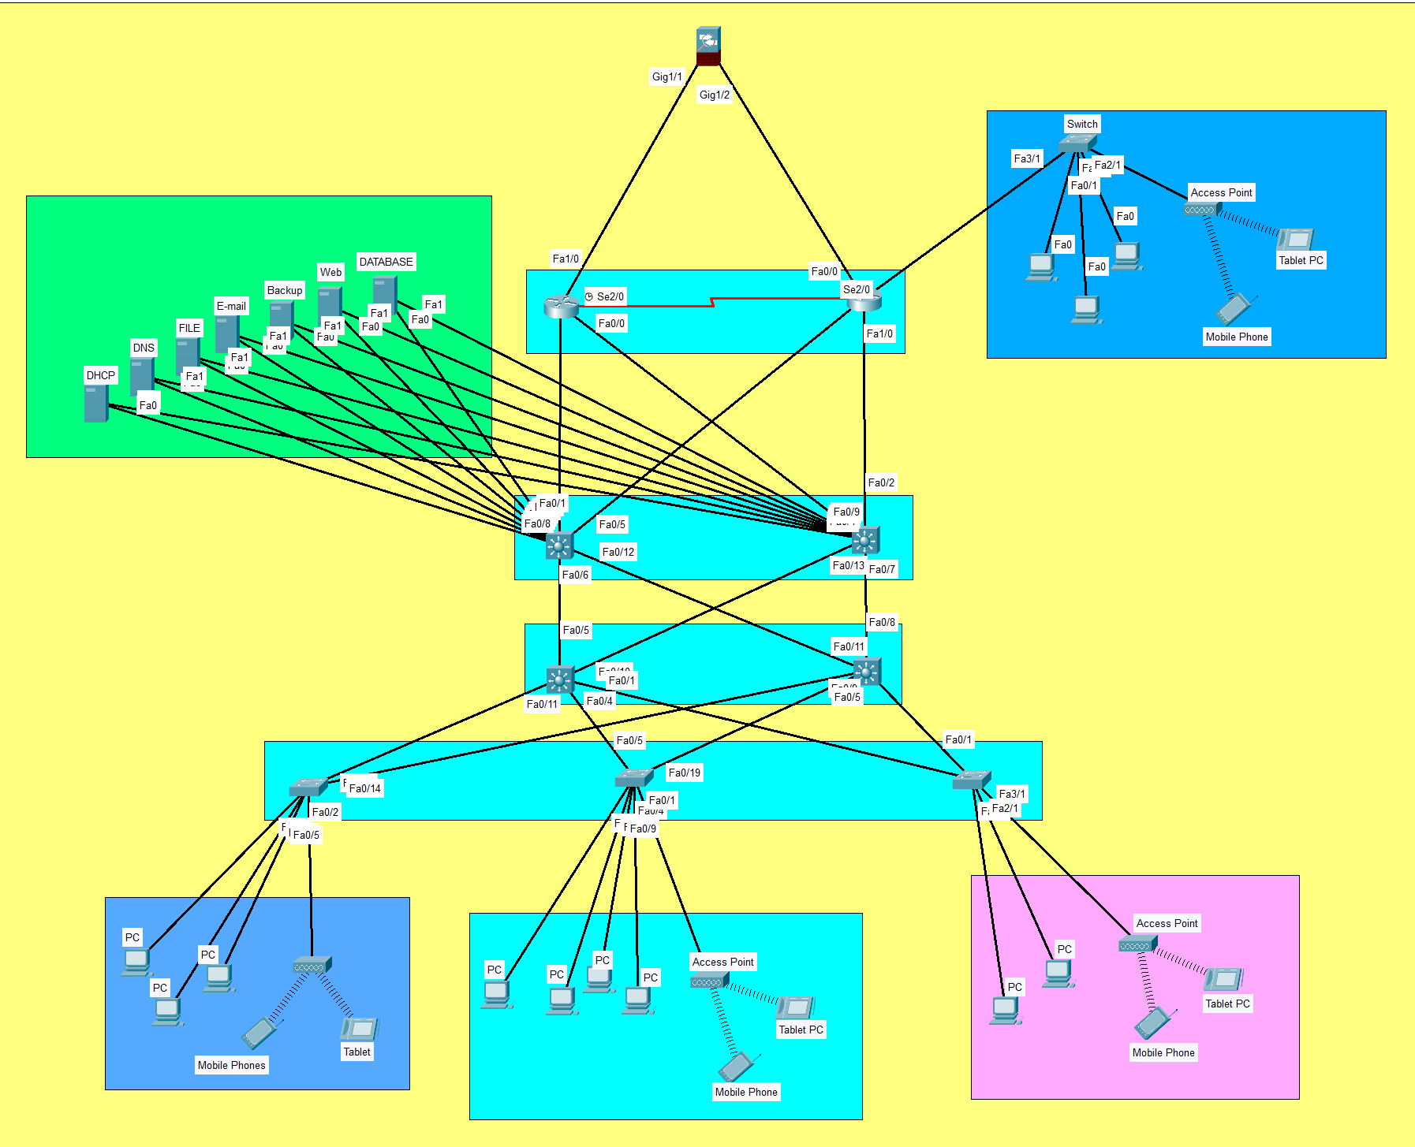
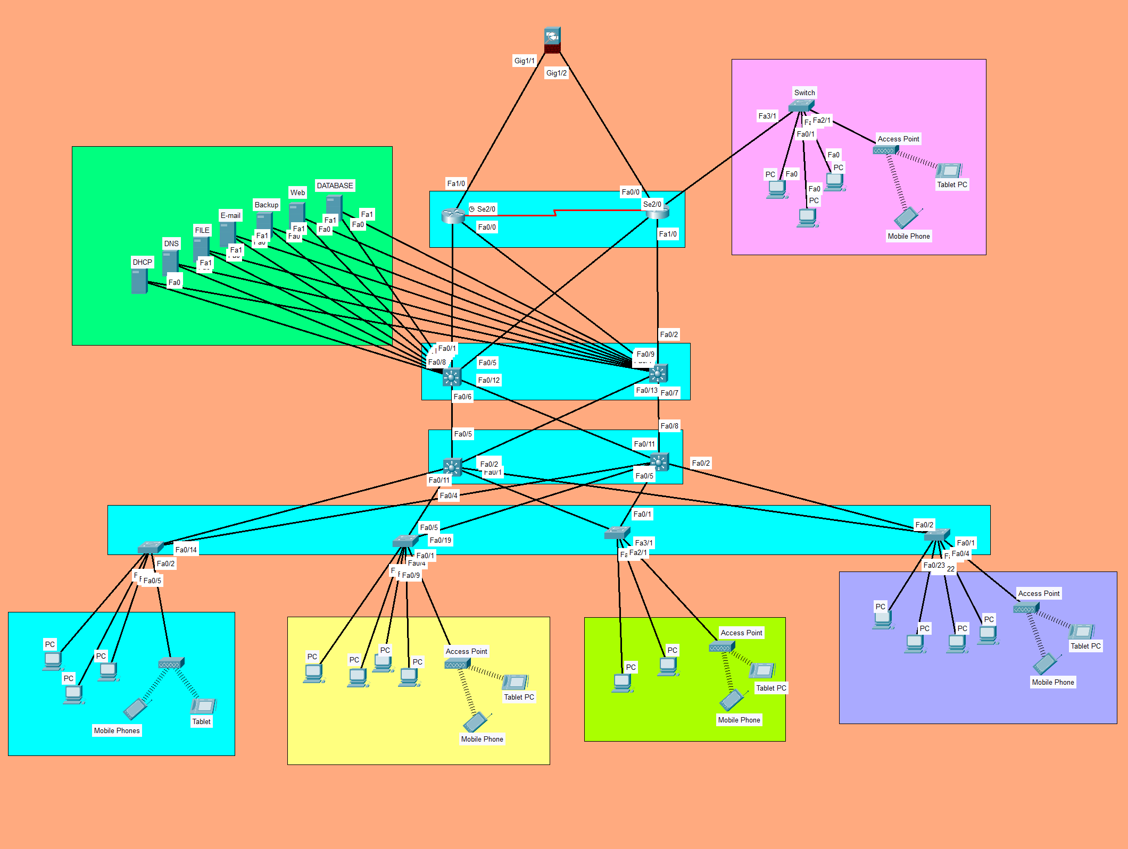
Logical Topology
ISP
Regular Branch - B
Regular Branch - E
Regular Branch - C
Main Branch - A
Regular Branch - D

Slide 5
Main Branch - A
CAT-7
IP Address – 172.16.0.0/18
Network Address – 172.16.0.0
Broadcast Address – 172.16.63.255
Subnet Mask – 255.255.192.0
No. of usable hosts - 11500
Firewall
CAT-6
CAT-6
CAT-6
Router
Main Department
Core Layer
Server Room
Multi Layer Switch
Multi Layer Switch
Distribution Layer
Switch
Access Layer
CAT-6
CAT-6
CAT-6
CAT-6
Department - 3
Department - 4
Department - 1
Department - 2

Slide 6
Regular Branch - B
CAT-7
IP Address – 172.16.64.0/18
Network Address – 172.16.64.0
Broadcast Address – 172.16.127.255
Subnet Mask – 255.255.192.0
No. of usable hosts - 8250
CAT-6
CAT-6
CAT-6
Router
Main Department
Server Room
Core Layer
CAT-6
Multi Layer Switch
Multi Layer Switch
Distribution Layer
Switch
Access Layer
CAT-6
CAT-6
CAT-6
Department - 1
Department - 2
Department - 3

Slide 7
Regular Branch - C
CAT-7
IP Address – 172.16.128.0/19
Network Address – 172.16.128.0
Broadcast Address – 172.16.159.255
Subnet Mask – 255.255.224.0
No. of usable hosts - 7620
CAT-6
CAT-6
CAT-6
Router
Main Department
Server Room
Core Layer
CAT-6
Multi Layer Switch
Multi Layer Switch
Distribution Layer
Switch
Access Layer
CAT-6
CAT-6
CAT-6
Department - 1
Department - 2
Department - 3

Slide 8
Regular Branch - D
CAT-7
IP Address – 172.16.160.0/20
Network Address – 172.16.160.0
Broadcast Address – 172.16.175.255
Subnet Mask – 255.255.240.0
No. of usable hosts - 4060
CAT-6
CAT-6
CAT-6
Router
Main Department
Server Room
Core Layer
CAT-6
Multi Layer Switch
Multi Layer Switch
Distribution Layer
Switch
Access Layer
CAT-6
CAT-6
CAT-6
Department - 1
Department - 2
Department - 3

Slide 9
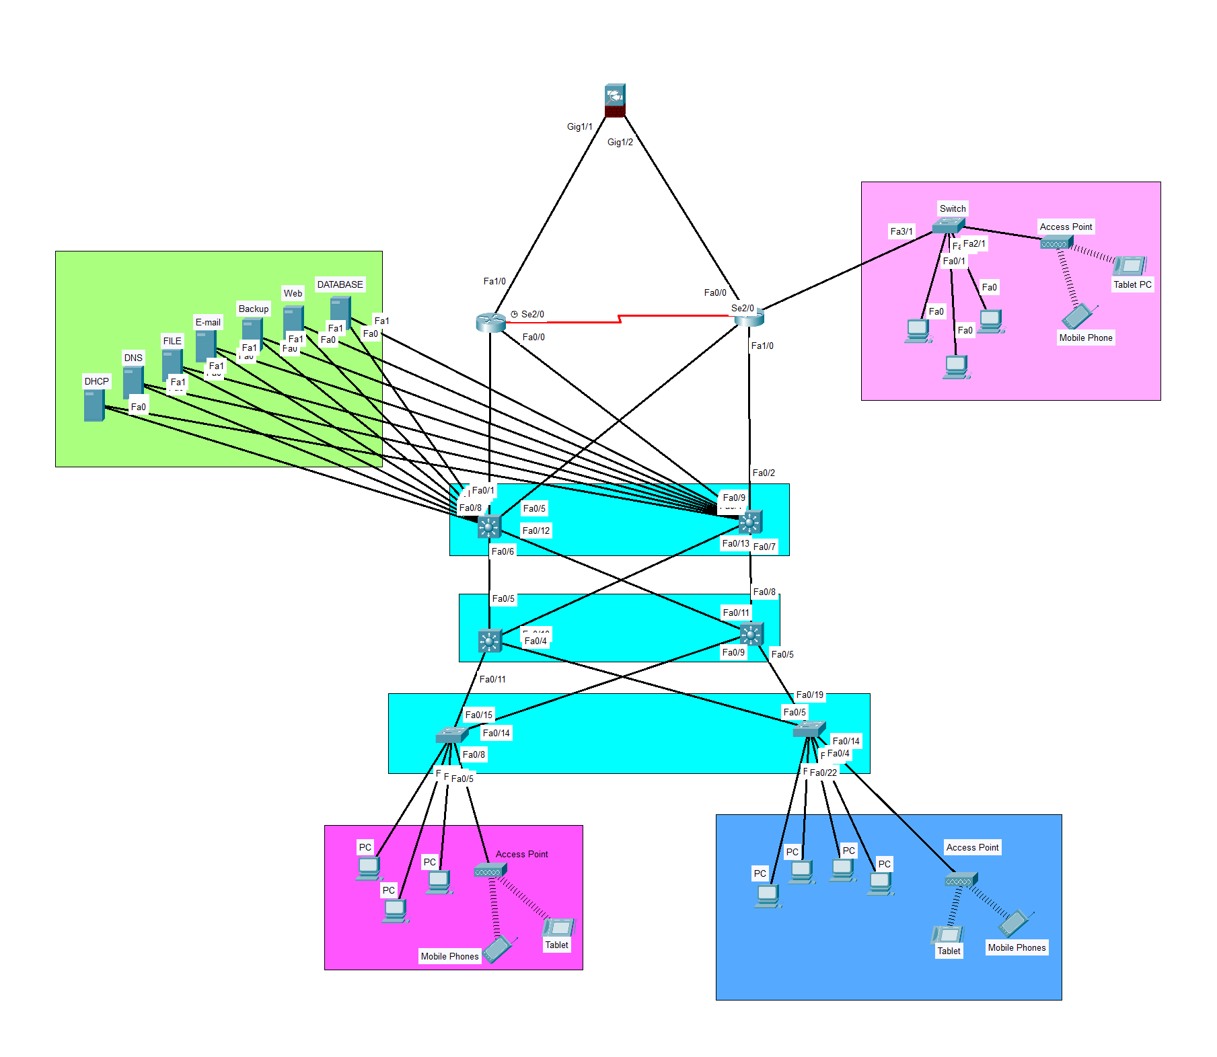
Regular Branch - E
CAT-7
IP Address – 172.16.176.0/21
Network Address – 172.16.176.0
Broadcast Address – 172.16.183.255
Subnet Mask – 255.255.248.0
No. of usable hosts - 2046
CAT-6
CAT-6
CAT-6
Router
Main Department
Server Room
CAT-6
Multi Layer Switch
Core Layer
Multi Layer Switch
Distribution Layer
Switch
Access Layer
CAT-6
CAT-6
Department - 1
Department - 2

Slide 10
PHYSICAL TOPOLOGY

Slide 11
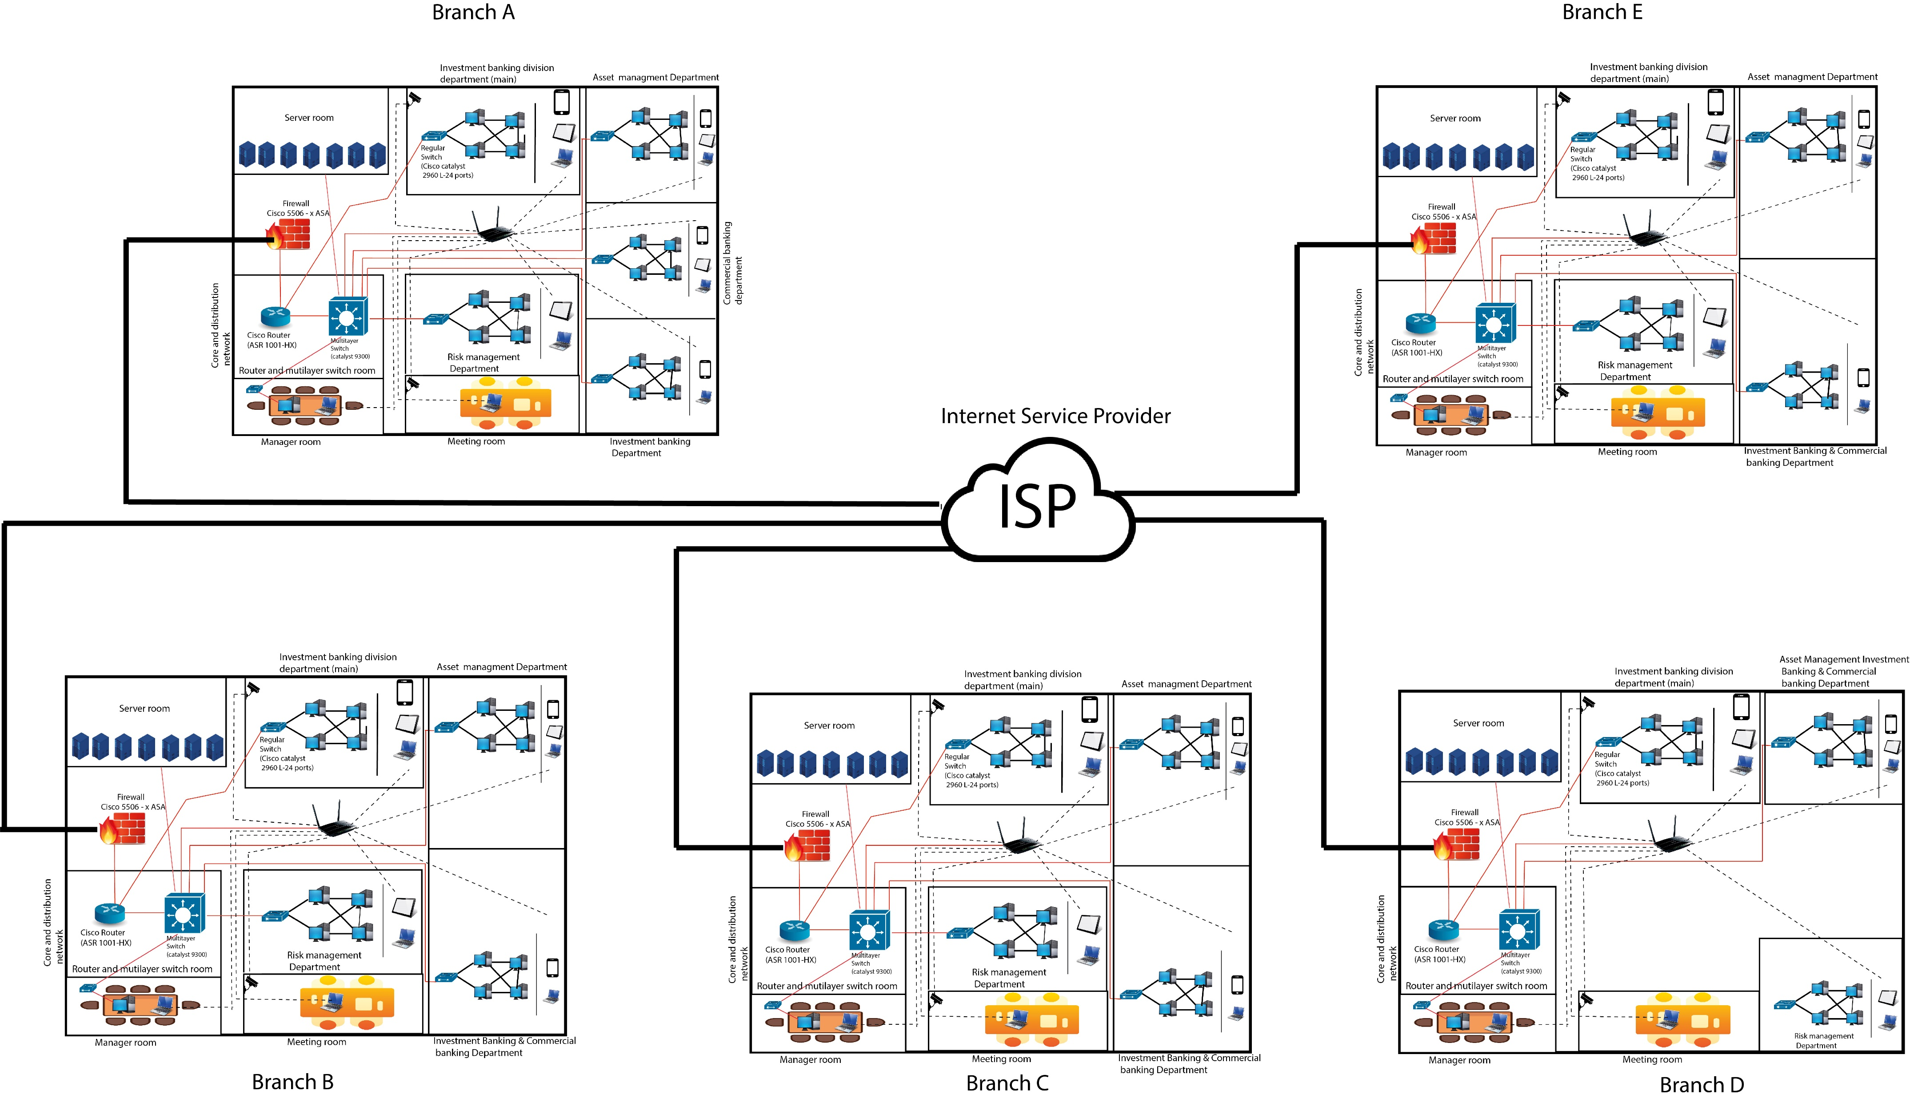
Physical Topology
CAT-6
CAT-6
CAT-6
Router
CAT-6
Multi Layer Switch
Core Layer
Multi Layer Switch
Distribution Layer
Switch
Access Layer
CAT-6
CAT-6

Slide 12
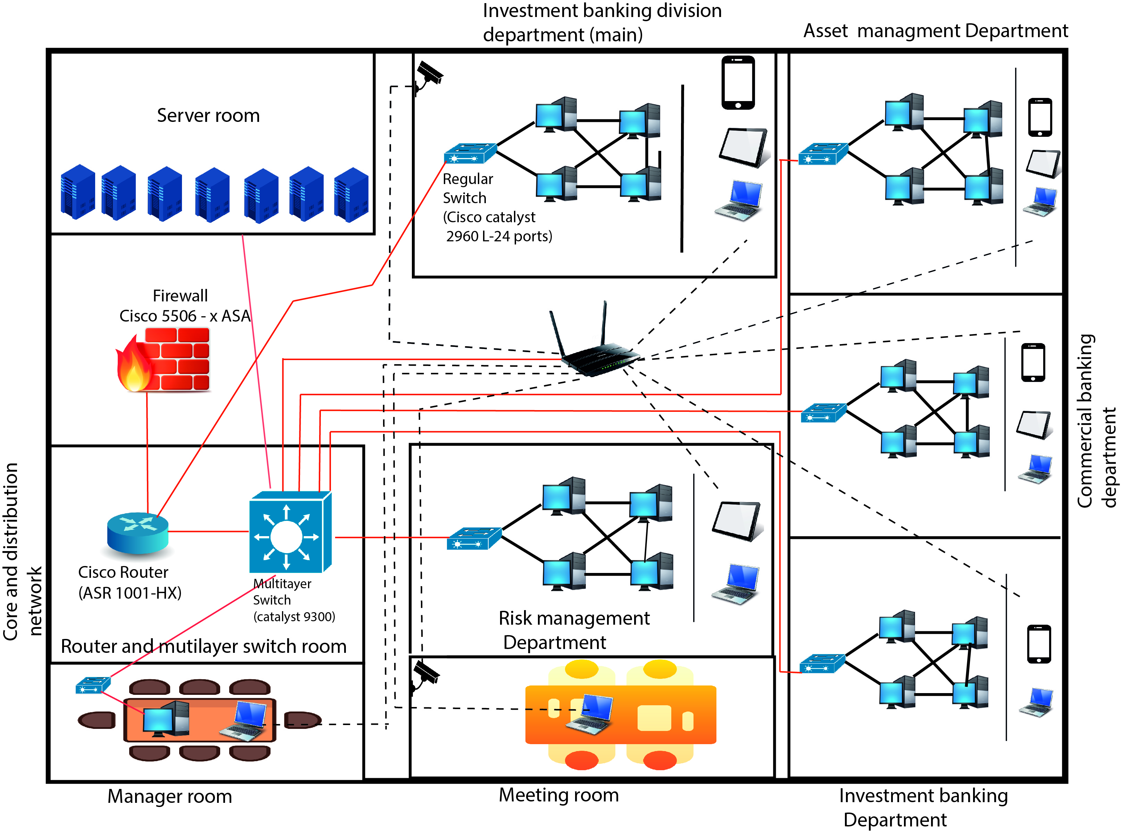
Main Branch - A
CAT-6
CAT-6
CAT-6
Router
CAT-6
Multi Layer Switch
Core Layer
Multi Layer Switch
Distribution Layer
Switch
Access Layer
CAT-6
CAT-6

Slide 13
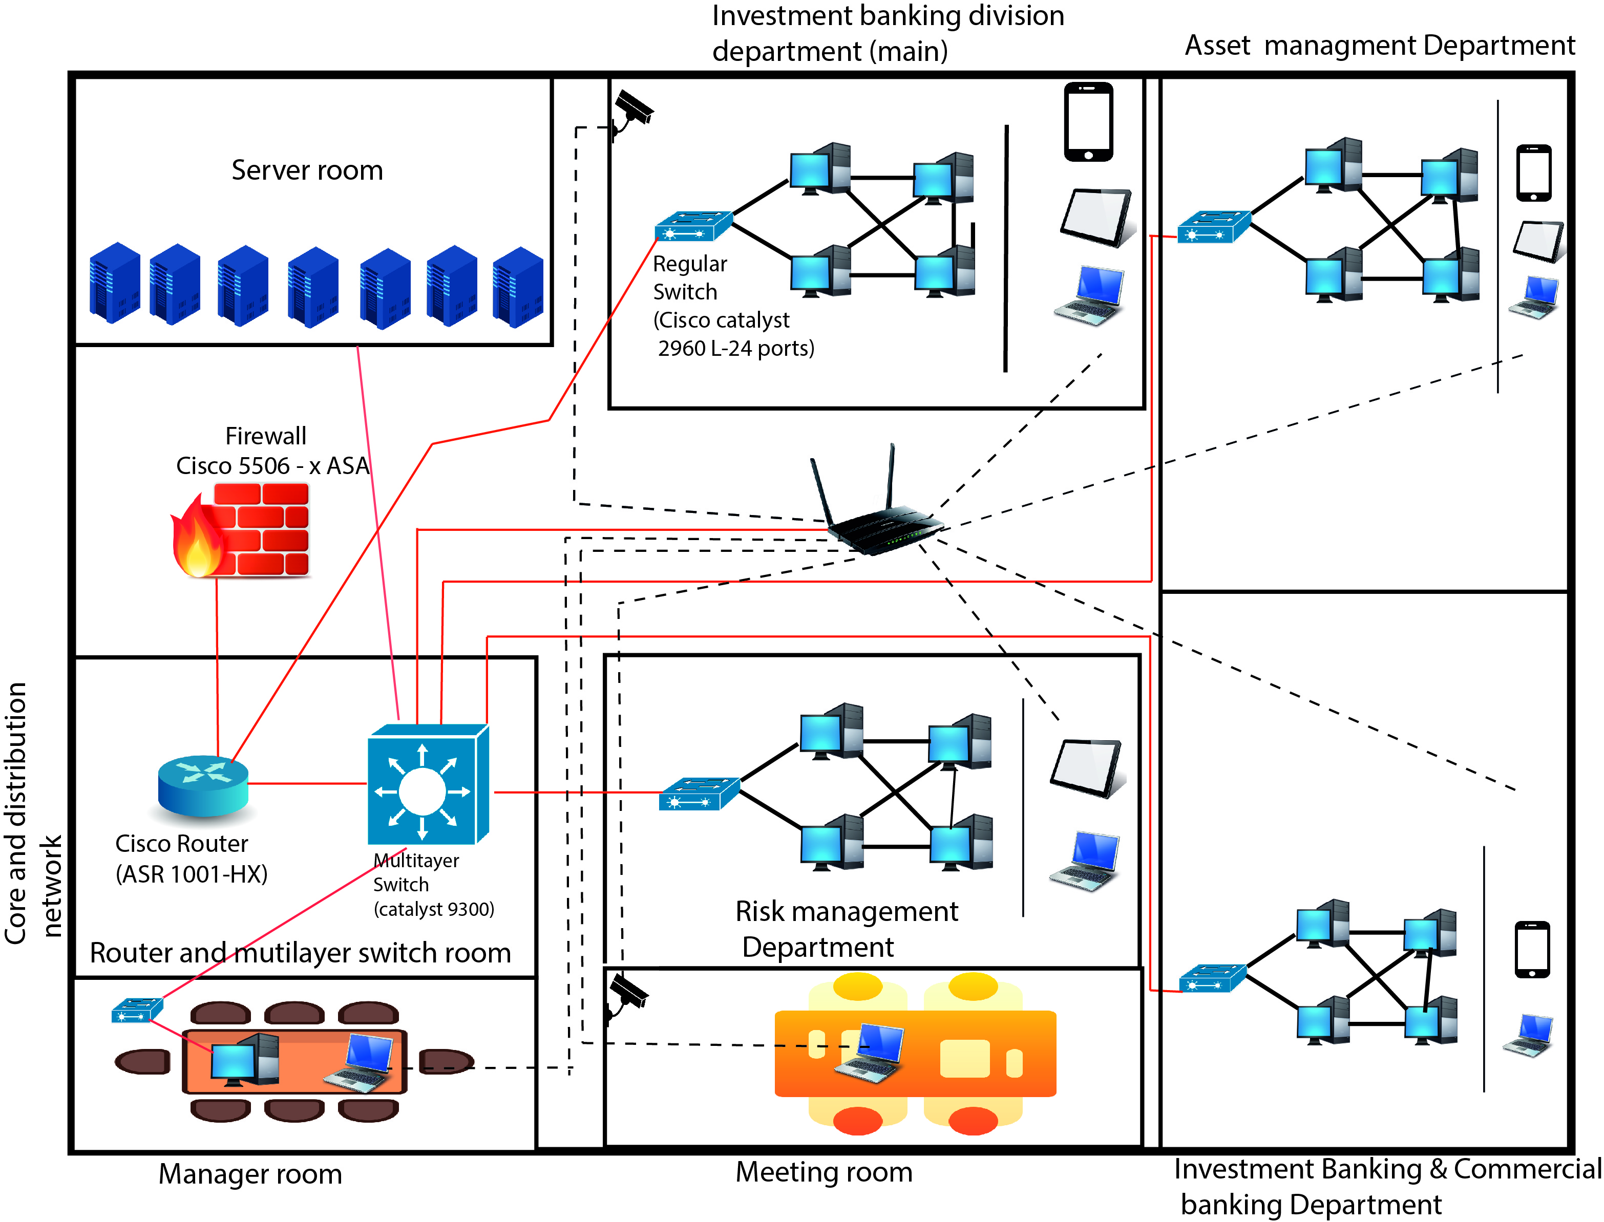
Regular Branch – B / Regular Branch – C / Regular Branch - D
CAT-6
CAT-6
CAT-6
Router
CAT-6
Multi Layer Switch
Core Layer
Multi Layer Switch
Distribution Layer
Switch
Access Layer
CAT-6
CAT-6

Slide 14
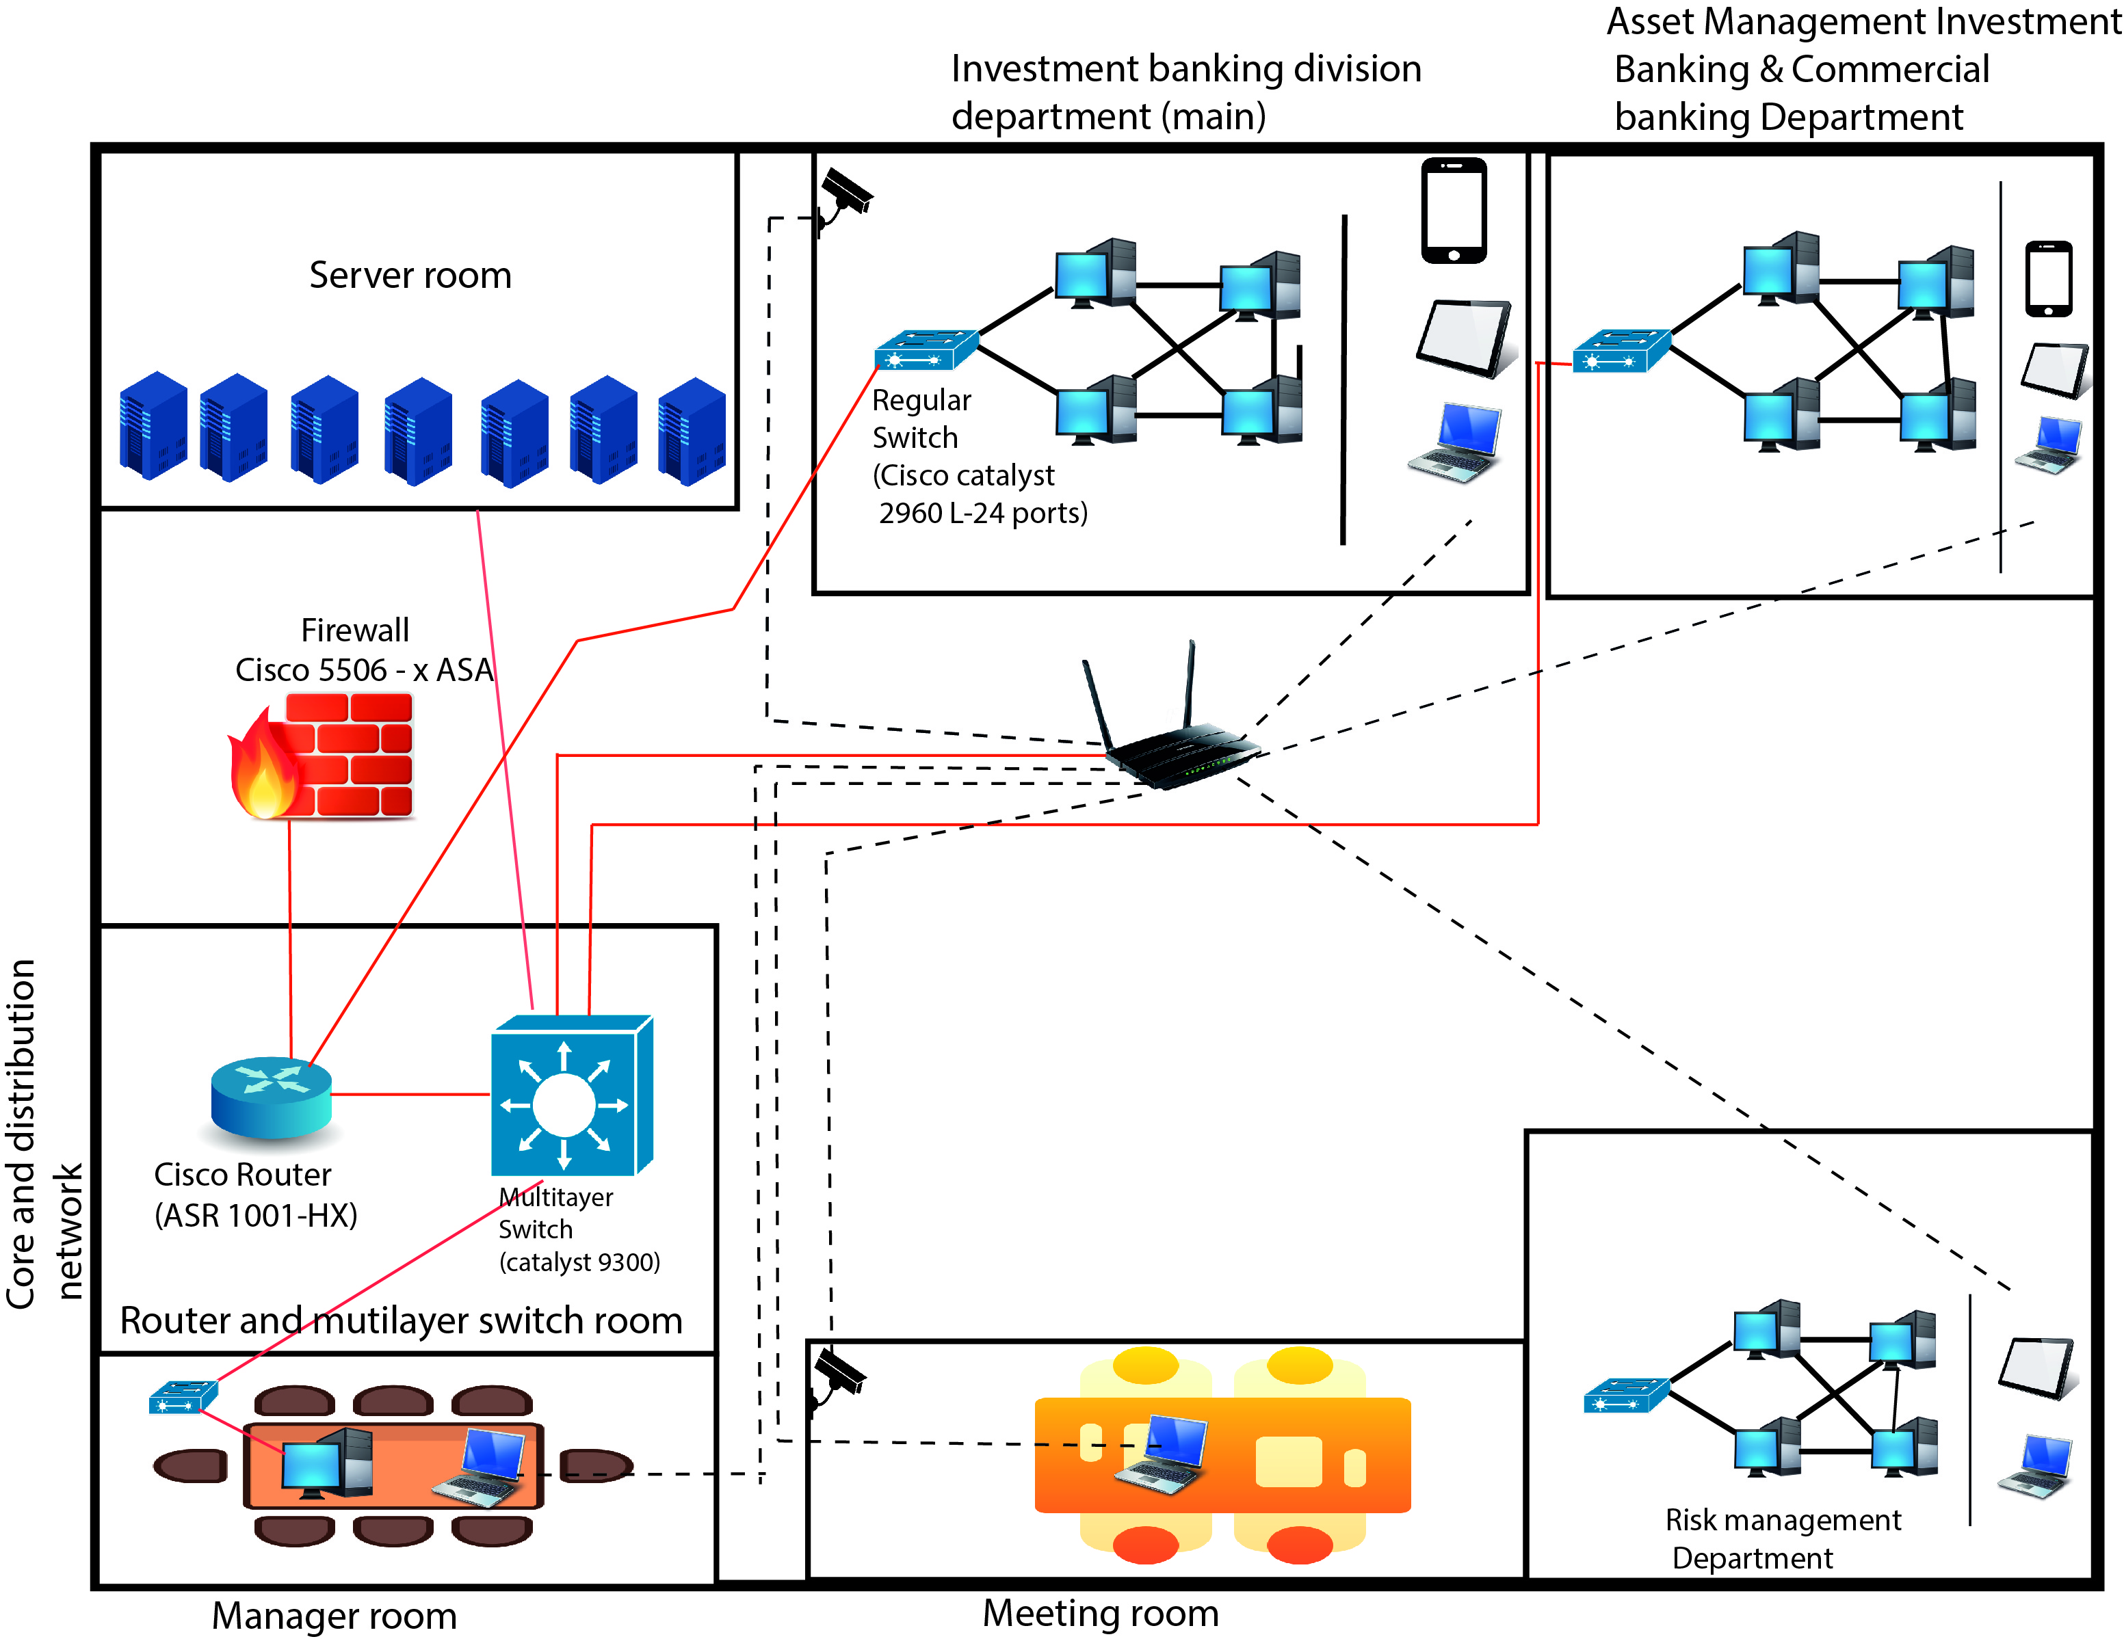
Regular Branch – E
CAT-6
CAT-6
CAT-6
Router
CAT-6
Multi Layer Switch
Core Layer
Multi Layer Switch
Distribution Layer
Switch
Access Layer
CAT-6
CAT-6

Slide 15
appropriate devices for the design

Slide 16
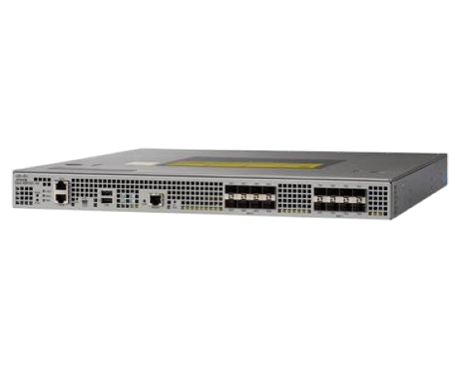

asr 1001- HX Router
High system bandwidth-60-Gbps
Port configuration –Allow for flexible connectivity options within your network
On demand crypto capability (Speed up to 29 Gbps)
Wan aggregation
Data center interconnect
Intelligent WAN (IWAN)
Internet Edge

Slide 17

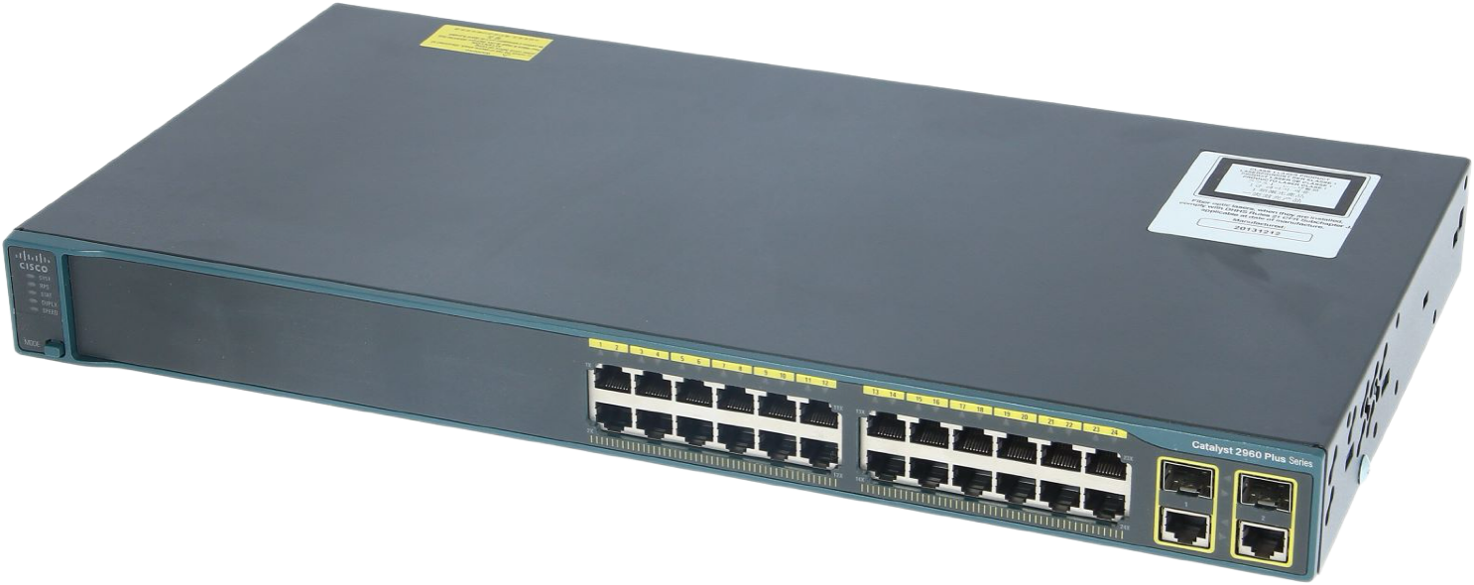
Cisco Catalyst 2960 – l switch (REGULAR)
Port Configuration – 24 GB ethernet ports with line rate forwarding performance
Uplink flexibility
POE + Support – from 120W – 370W
Dual purpose uplinks

Slide 18
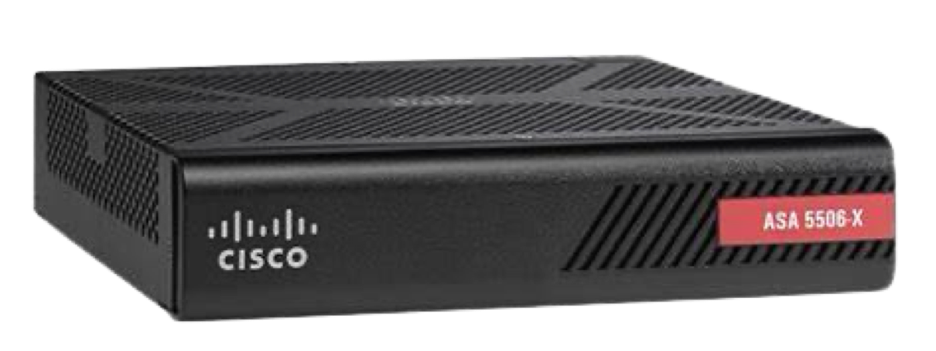

CISCO ASA 5506-X (Fire Wall)
High throughput and scalability
Provides next generation firewall services
( Ex – AVC, WSE, IPS, VPN & remote access)
Firewall is a network security device that acts as a barrier between your internal network and the external world .
(Primary purpose →Control and Filter Network traffic)

Slide 19
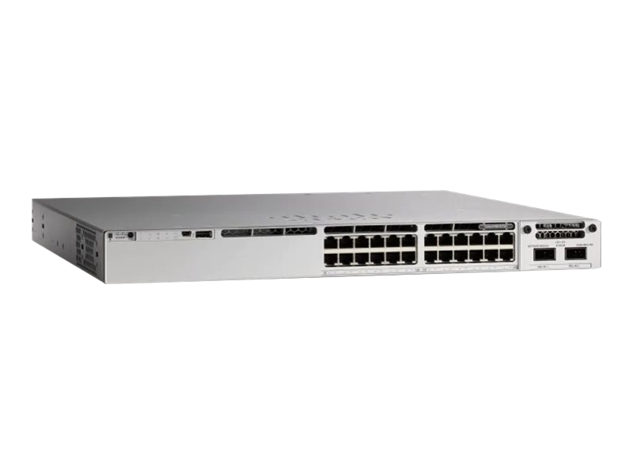
CISCO CATALYST 9300 MULTILAYER SWITCH
Stacking and uplink flexibility (1TB of stacking bandwidth)
Multigigabit ports
Advanced security and connectivity –
100GB IPsec in hardware
Secure tunnel connectivity
Enhanced application hosting

Slide 20

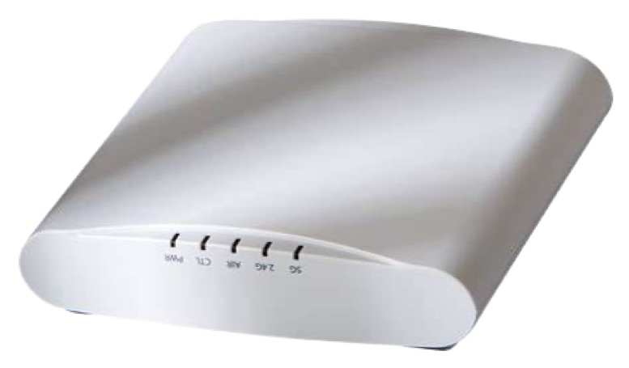

Ruckus 510 zoneflex Access Point
Up to 512 users can be used
1.2 Gbps Speed
Optimizing coverage and performance
Power over ethernet
Bring cutting edge 802.11 ac wave 2 technology to mid-tire segment
Network security features -
WPA2
Firewall rules
RADIUS

Slide 21
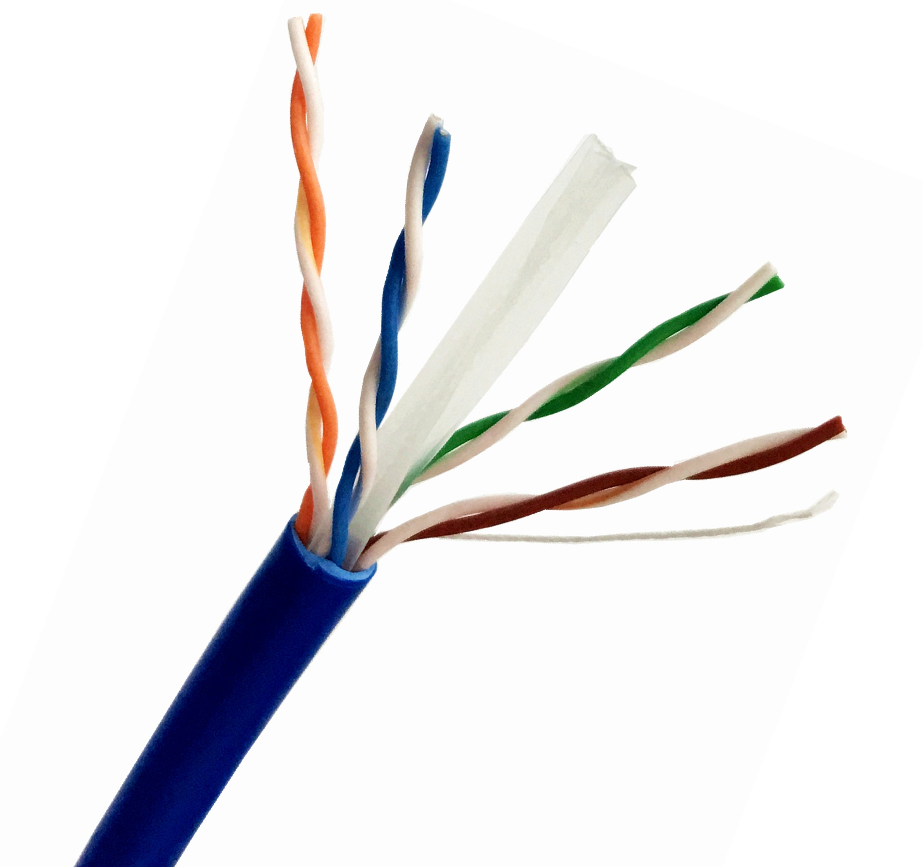
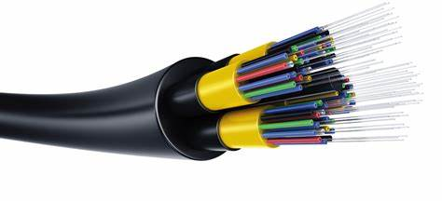
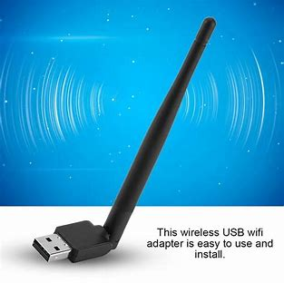
Copper Cables:
Cat 6/7 cable :-
Higher data tranfre rules.(support Gigabit ethernet).
Reduced Interference.
Future – Proofinbg.
Fiber:
Greater bandwidth.
Better realiblity.
More flexibility for the future.
Lower total cost of owenership.
Wireless Antena:
Improved range and coverage.
Flexibility.

Slide 22
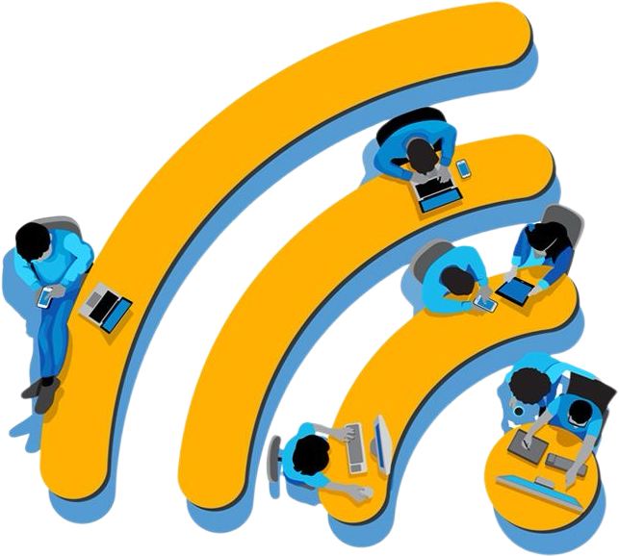
LAN Technologies
Ethernet:
uses twisted-pair copper cables or fiber-optic cables to connect devices
Ethernet frames contain source and destination addresses, data, and
error-checking information.
WIFI:
Wi-Fi allows wireless communication within a LAN. It uses radio waves to connect devices without physical cables.
Wi-Fi access points (APs) provide wireless connectivity. Devices with Wi-Fi capability connect to these APs.

Slide 23
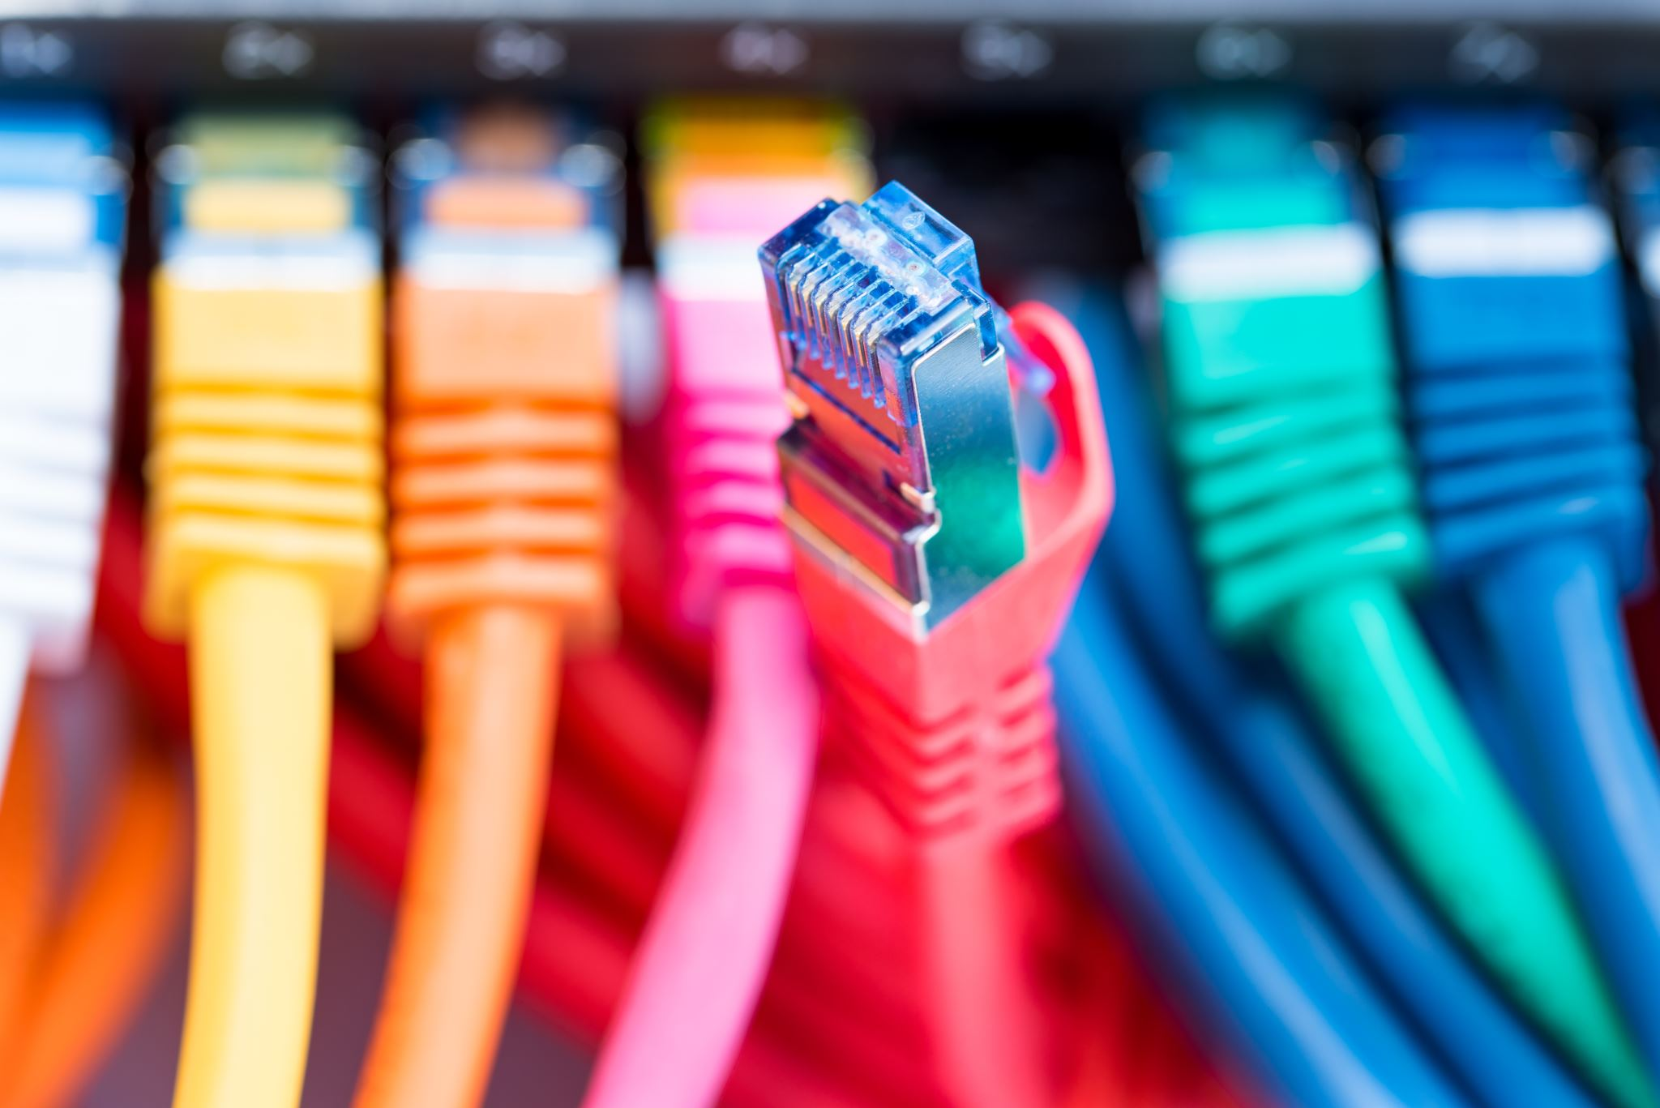
WAN Technologies
Packet Switching:
In packet switching, messages are broken into smaller packets. Each packet contains a payload and an identifying header.
optimizes routing and ensures efficient data transmission.
Multiprotocol Label Switching (MPLS):
MPLS is a protocol that efficiently routes data within a WAN. It uses labels to determine the best path for each packet.
It provides quality of service (QoS) features, making it suitable for critical applications.

Slide 24
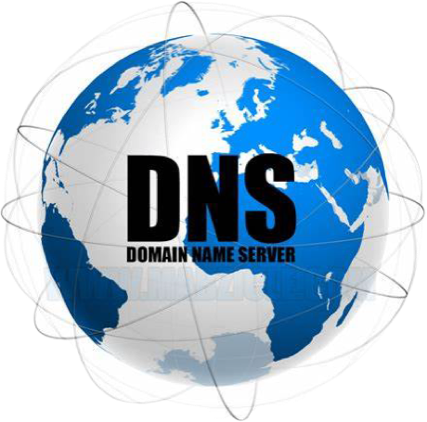
SERVERS
DNS SERVER
DNS servers are responsible for translating those names into numeric IP addresses. These IP addresses allow browsers to communicate with origin servers or content delivery network (CDN) edge servers, ultimately accessing website information. DNS servers work together in a chain, including recursive resolvers, root nameservers, top-level domain (TLD) nameservers, and authoritative nameservers.

Slide 25
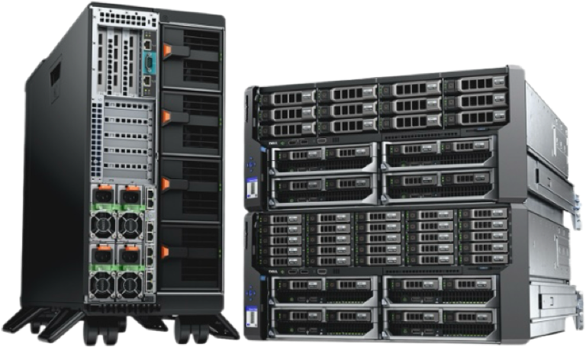
DHCP Server
Cisco IOS DHCP Server
DHCP server automatically assigns IP addresses and essential network configuration details to devices on the network. This eliminates the need for manual IP address assignment, which can be time-consuming and prone to errors
Redundancy
Failover Mechanism
Load Balancing
Active-Standby Configuration
Scalability
IP Address Pools
Subnet Segmentation
Superscopes
Security
MAC Address Filtering
DHCP Snooping

Slide 26


E-mail server
Microsoft Exchange Server is a business-class email and calendaring solution that helps increase user productivity while protecting data. It can be used as a hosted service or run on our own servers
Backup server
Dell EMC Data Domain is a purpose-built backup appliance designed for efficient data protection, offering scalability, security, and high performance.

Slide 27


WEB SERVER (iis)
IIS is a web server software developed by Microsoft. It enables hosting websites, web applications, and services on Windows servers, supporting various protocols like HTTP, HTTPS, FTP, and SMTP. It’s commonly used for deploying ASP.NET applications and managing web services
File server
NetApp FAS Storage Arrays provide customers with a balance of performance and capacity. Optimized for easy deployment and operations, NetApp FAS systems deliver the flexibility to handle future growth and cloud integration

Slide 28
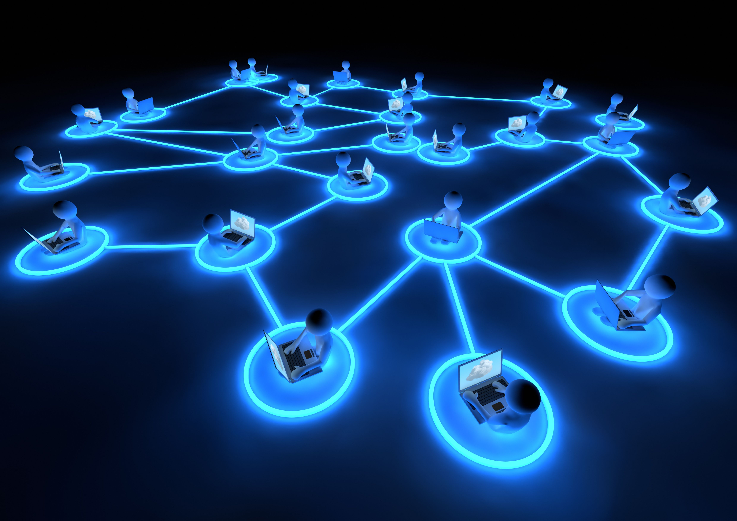
Protocols for Layers of ISO/OSI Model
Application Layer
HTTP :
Web browsing .
Enables users to interact with web application and retrieve info from servers
SMTP :
Ensures reliable email delivery across branches .
POP3 :
Allows employes to access their emails from different branches .
DNS :
Resolves domain names to IP addresses
SSH :
Secure remote access to servers and network devices.
FTP :
File sharing.

Slide 29
Protocols for Layers of ISO/OSI Model
Presentation Layer
SSL/TLS :
Provides secure communication.
VNC :
Allows remote desktop access to computers across the network .
LDAP :
Centralized user management .

Slide 30
Protocols for Layers of ISO/OSI Model
Session Layer
NFS :
Enables file sharing across heterogeneous systems.
PAP :
Verifies user credintial for secure access.
PPTP :
Allows secure communication between branches over public network.
SMB :
File sharing.

Slide 31
Protocols for Layers of ISO/OSI Model
Protocols for Layers of ISO/OSI Model
Transport Layer
TCP :
Reliability, flow control.
UDP :
Allow faster data transmission .
STCP :
Resillience, message oriented connection.
DCCP :
Adaptive congestion control.

Slide 32
Protocols for Layers of ISO/OSI Model
Protocols for Layers of ISO/OSI Model
Protocols for Layers of ISO/OSI Model
Network Layer
IP :
Scalability, Interconnectivity.
OSPF :
Dynamic routing , load balancing .
BGP :
Policy based routing.
VRRP :
High availability.
ICMP :
Network troubleshooting

Slide 33
Protocols for Layers of ISO/OSI Model
Protocols for Layers of ISO/OSI Model
Protocols for Layers of ISO/OSI Model
Protocols for Layers of ISO/OSI Model
Data Link Layer
SDLC :
Error control, efficiency.
HDLC :
Standarlization , multilink support.
PPP :
Authentication, Error detection and compression.
LLC :
Flow control, error handling .

Slide 34
Protocols for Layers of ISO/OSI Model
Protocols for Layers of ISO/OSI Model
Protocols for Layers of ISO/OSI Model
Protocols for Layers of ISO/OSI Model
Protocols for Layers of ISO/OSI Model
Physical Layer
Ethernet :
Cost effective , Scalability.
Fiber Optic cables :
High bandwidth, Long distances.
USB :
Peripheral sharing, Cost efficient, Ease of use.
Bluetooth :
Local Connecting, Low power.

Slide 35
IP ADDRESS RANGES
No: of hosts in LMN company – 33 430
Chosen major IP – Class B → 172.16.0.0 / 16
Branch | No: of hosts / Required IP addresses | Required bits | Reason
A (Main) | 11500 | 14 | 2^14 > 11500
B | 8250 | 14 | 2^14 > 8250
C | 7620 | 13 | 2^13 > 7620
D | 4060 | 12 | 2^12> 4060
E | 2046 | 11 | 2^11 > 2000

Slide 36
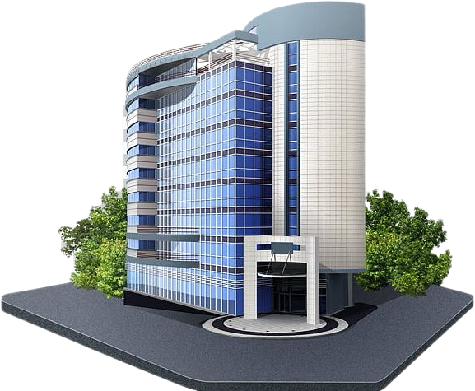
Branch A (main)
To allocate 11500 IP addresses, it’s needed to allocate
14 bits as the host ID part.
172.16.00000000.00000000
2 subnet bits are there.
1) 172.16.00000000.00000000
2) 172.16.01000000.00000000
3) 172.16.10000000.00000000
4) 172.16.11000000.00000000
IP address for branch A → 172.16.00000000.00000000
( 172.16.0.0 /18 )

Slide 37
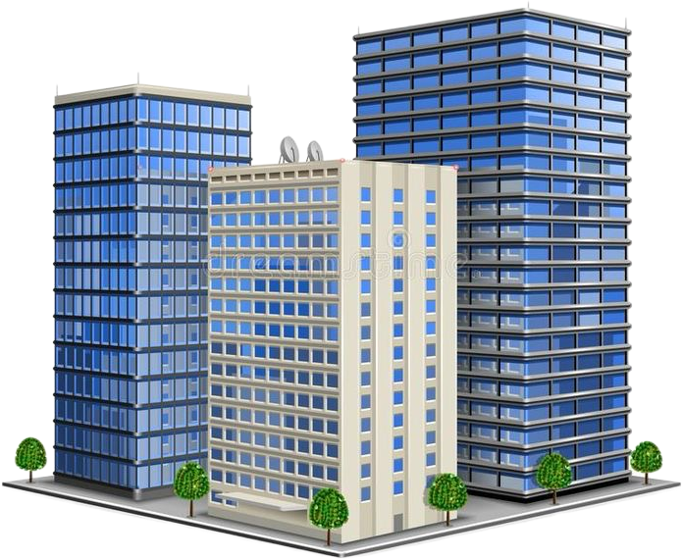
IP addresses of branches by VLSM
A - 172.16.00000000.00000000 – 172.16.0.0 /18
B - 172.16.01000000.00000000 – 172.16.64.0 /18
C - 172.16.10000000.00000000 – 172.16.128.0 /19
D - 172.16.10100000.00000000 – 172.16.160.0 /20
E - 172.16.10110000.00000000 – 172.16.176.0 /21

Slide 38
IP ADDRESS RANGES OF BRANCHES
Branch | Address | Available range | Broadcast domain
A | 172.16.0.0 /18 | 172.16.0.1 - 172.16.63.254 | 172.16.63.255
B | 172.16.64.0 /18 | 172.16.64.1 - 172.16.127.254 | 172.16.127.255
C | 172.16.128.0 /19 | 172.16.128.1 - 172.16.159.254 | 172.16.159.255
D | 172.16.160.0 /20 | 172.16.160.1 - 172.16.175.254 | 172.16.175.255
E | 172.16.176.0 /21 | 172.16.176.1 - 172.16.183.254 | 172.16.183.255

Slide 39
Overall Budge Calculation -- Assumptions
There are 6 floors in the main branch building, and 4 floors for other branches. There are 4 floors in the each building of B,C,D,E branches.
1st floor is allocated for manager room and the meeting room.
Then, rest of the floors are for other departments, one floor for each.
We allocate 4 access points for one floor and another 2 for the first floor.
For 1 department → 2300 employees and assumed that each employee has one PC .
Space allocated for an employee = 150 square feet
Area of one floor – 2300 * 150 = 345 000 square feet ( length = 2300 feet , width = 150 feet )
Height of one floor = 20 feet. Height of the building = 120 feet
1st floor → there are 4 rooms there. Router and multilayer switch room, manager room, meeting room, server room.
Dep 5
Dep 4
Dep 3
Dep 2
Dep 1
1st floor

Slide 40
Area of one room – 86 250 square feet ( length = 297 , width = 290 feet )
Distance between 2 rooms – 10 feet
We have used mesh topology when connecting some devices. So that, when calculating cable expenditure, we have multiplied the cost by 4.
Each connection between devices will require 2 lengths of CAT 6 cable ( one for transmitting and one for receiving .) So, we have multiplied by 2
Router , multi layer switch room and the meeting room only has access points, no cabling inside
Assume that, no: of PCs = No: of employees work in the branch
We didn’t calculate the expenditure for PCs because we only created a relevant network that is appropriate for over 30 000 employees.
And also, we didn’t calculate the expenditure for RJ45 ports. It also should be provided by the LMN company.
Router, multilayer switch room
Router, multilayer switch room
Router, multilayer switch room
Router, multilayer switch room

Slide 41
OVERALL BUDGET CALCULATION
1) Branch A (main)
1. Expenditure for devices
Device | Quantity | Current unit price Of the device ( $ ) | Total expenditure for the relevant device ( $ )
Cisco 5506-X ASA ( Firewall ) | 1 | 1345.00 | 1345.00
Cisco ASR 1001 HX ( Router ) | 2 | 85,736.16 | 171,472.32
Cisco catalyst 9300 ( Multilayer switch ) | 4 | 7,071.41 | 28,285.64
Cisco catalyst 2960- L 24 ports ( Regular switch ) | 5 | 3,950.99 | 19,754.95
Ruckus R510 ( Access point ) | 22 | 359.99 | 8279.77
Servers | 7 | 6000 | 42 000
Total = $271 092.68

Slide 42
2. Expenditure for cables
CAT 6 cable
Section allocating cables | Needed length ( feet ) | Total ( $ )
Firewall to router, multilayer switch room | 290 * 4 = 1160 | 232
Inside router, multilayer switch room | 297 * 8 = 2376 | 475.20
Router, multilayer switch room to server room | 10 * 28 = 280 | 56
Router, multilayer switch room – manager room | 10 * 4 = 40 | 8
Length of CAT 6 needed to connect other floors ( departments ) from the 1st floor | 20 + 40 + 60 + 80 + 100 = 300 | 60
Switch – PCs | 11500 * 2300 = 26 450 000 | 5 290 000
Unit price of CAT 6 cable = $200 for 1000 feet Total = $529 831.20

Slide 43
2) Branch B,C,D,E
1. Expenditure for devices
Device | Quantity | Current unit price Of the device ( $ ) | Total expenditure for the relevant device ( $ )
Cisco 5506-X ASA ( Firewall ) | 1 | 1345.00 | 1345.00
Cisco ASR 1001 HX ( Router ) | 2 | 85,736.16 | 171,472.32
Cisco catalyst 9300 ( Multilayer switch ) | 4 | 7,071.41 | 28,285.64
Cisco catalyst 2960- L 24 ports ( Regular switch ) | 4 | 3,950.99 | 15,803.96
Ruckus R510 ( Access point ) | 18 | 359.99 | 5039.86
Servers | 7 | 6000 | 42,000
Total = $263 946.78
Total for 4 branches = $1055 787.12

Slide 44
2. Expenditure for cables
CAT 6 cable
Section allocating cables | Needed length ( feet ) | Total ( $ )
Firewall to router, multilayer switch room | 290 * 4 = 1160 * 4 | 928
Inside router, multilayer switch room | 297 * 8 = 2376 * 4 | 1900.8
Router, multilayer switch room to server room | 10 * 28 = 280 * 4 | 224
Router, multilayer switch room – manager room | 10 * 4 = 40 * 4 | 32
Length of CAT 6 needed to connect other floors ( departments ) from the 1st floor | 20 + 40 + 60 + 80 = 200 * 4 | 80
Switch – PCs | 21 976 * 2300 = 50 544 800 | 10 108 960
Unit price of CAT 6 cable = $200 for 1000 feet Total = $10 112 124.8

Slide 45
Total budget for branch A ( Main ) = $271 092.68 + $529 831.20
= $800 923.68
Total budget for branch B,C,D,E = 4 * 263 946.78 + 10 112 124.8
= $1055 787.12 + 10 112 124.8
= $11 167 911.90
Total budget for our project = $ 11 968 835.60

Slide 46
Thank
you
Router, multilayer switch room
Router, multilayer switch room
Router, multilayer switch room
Router, multilayer switch room

Slide 47






Slide 48

Any questions?
Router, multilayer switch room
Router, multilayer switch room

